Slide 1
Common Channel Signalling

Slide 2
CONCEPTS OF common channel signalling
MESSAGE TYPES( basic, homogeneous, non homogeneous)
How capable of ccs
How telephone call is established
BASIC ERROR DETECTION METHODS
FORWARD AND BACKWARD ERROR CORECTIONS
HOW TO FORM CRC(CYCLIC REDUNCY CODE)
HOW CRC IS REALISED

Slide 3
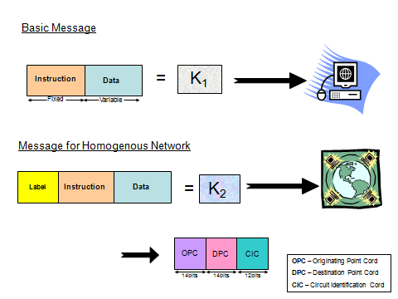
MESSAGE TYPES
BASIC MESSAGE
HOMOGENIOUS MESSAGE
NON HOMOGENEOUS MESSAGE

Slide 4


Basic Message
= K₁
Instruction
Instruction
Data
Data
Fixed
Variable
Message for Homogenous Network
Instruction
Data
= K₂
Label
Label
OPC
DPC
CIC
OPC – Originating Point Cord
DPC – Destination Point Cord
CIC – Circuit Identification Cord
14bits
14bits
12bits

Slide 5

WHY NOT?
Message for Non-Homogenous Network
K₂
SIO
K₂
SIO
Label
Instruction
Data
National or International Message
User
Part
SIO - Service Information Octel
K₂ - Message for Homogenous Network
4bits
4bits
Now we are ready with the complete message, can we transmit it just as it is?
NO

Slide 6
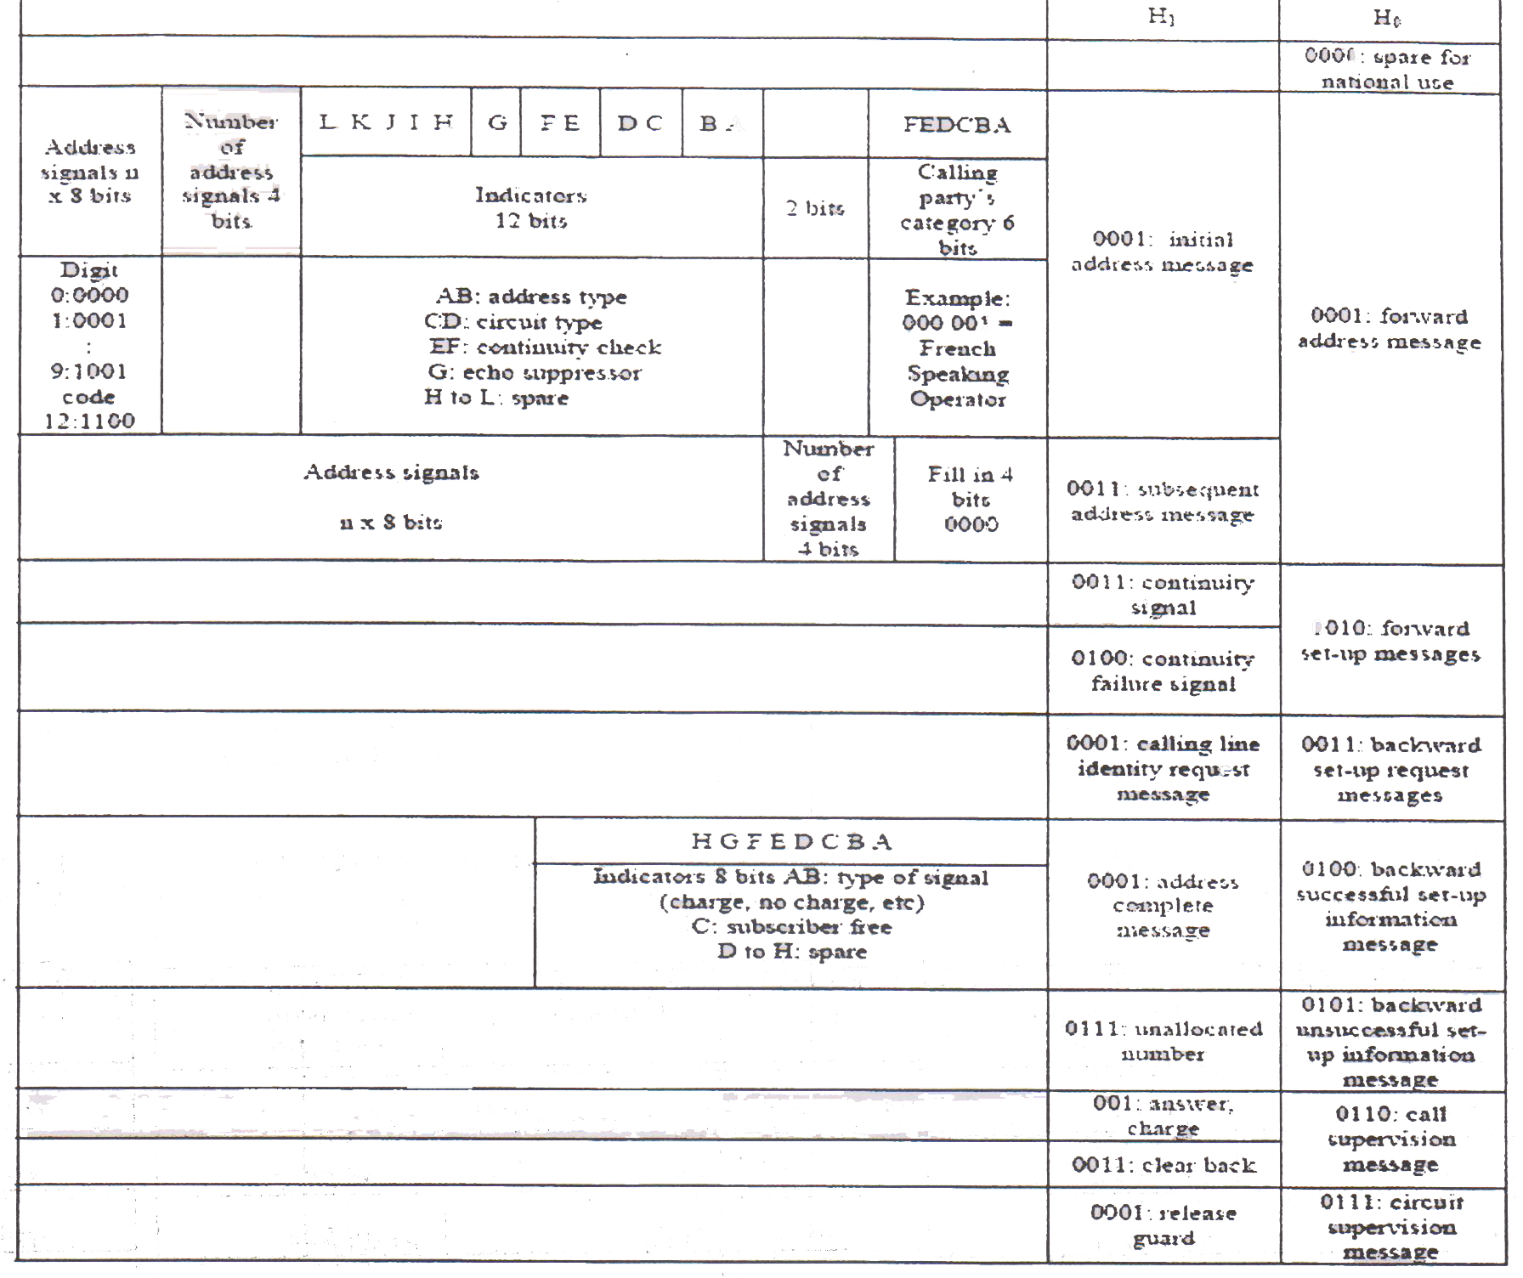
IAM
ACM
ANC
CBK

Slide 7
 | 0000 | 0001 | 0010 | 0011 | 0100 | 0101 | 0110 | 0111 | 1000 | 1001 | 1010 | 1011 | 1100 | 1101 | 1110 | 1111
0000
0001 |  | IAM |  | SAM
0010 |  | OSM |  | COT | CCF
0011 |  | ORQ
0100 |  | ACM | CHO
0101 |  | SEC | COC | NNC | ADI | CFL | SSB | UNN | LOS | SST | ACB | DPN | MPR |  |  | EUM
0110 |  | ANC | ANN | CBK | CLF | RAN | FOT | CCL |  |  |  |  |  |  |  | EAM
0111 |  | RLG | BLO | BLA | UBL | UBA | CCR | RSC
1000 |  | MGB | MBA | MGU | MUA | HOA | HBA | HGU | HUA | GRS | GRA | SGB | SBA | SGU | SUA
1001 |  | CFM | CPM | CPA | CSV | CVM | CHM | CLI
1010
1011
1100
1101
1110
1111
H1
H0
Spare reserved for national use
Spare reserved for international and basic national use
Spare reserved for national use

Slide 8

Basic concept of message transmission to establish a call
IAM
B
ACM
A
ANC
Ringing current to subscriber “B” n ringback tone to subscriber “A”
Speech
CBK
Variable
Node X
Node Y
IAM
(Initial address message)
H₀
H₁
0001
0001
20 Bits
4 Bits
Dial Number
ACM
(Answer complete mesaage )
H₀
H₁
0100
0001
Fixed (8 Bits)
ANC
H₀
H₁
0110
0001
No Data
CBK
H₀
H₁
0110
0011
No Data

Slide 9
HOW THE COMMON CHANNEL SIGNALLING WORKS
ASSUME A CALL IS ESTABLISHED IN A NETWORK WHERE THERE ARE TWO EXCHANGES(EX X & EX Y) ARE CONNECTED WITH 16 PCM SYSTEMS.
THE CALL IS CONNECTED VIA CIRCUIT NUMBER 305. ASSUME P(0) TS16 & P1(1) IS USED FOR COMMON CHANNEL SIGNALLING.
DRAW HOW THE SIGNALS ARE ESTABLISHED BETWEEN THE EXCHANGES(assume the call is establised, and after the call, A keeps the receiver first)
Calculate the total times taken for forward & backward signalling

Slide 10
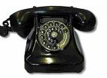

Need to transfer message between A to B
X
exchange
P0f
Y
exchange
P1f
P15f
P0b
P1b
P15b
Customer A
Customer B

Slide 11
Helicopter View
Exchange X
Exchange X
IAM
( P0f TS16 )
ACM
( P0b TS16 )
( P9 TS28)
RBT
( P0b TS16 )
ANS
speaking
( P9f TS28)
( P9b TS28)
( P0f TS16 )
CBR

Slide 12
Name | Standards | Purpose
IAM | Initial Address Message | Dialing Information
ACM | Address Complete Message | B customer free or not
RBT | Ring Back Tone | Tone herd by A
ANS | Answer Signal Charge | B customer answer or not
CBR | Call Back Tone | Release the circuit

Slide 13
CALCULATION !

Slide 14
= (31 * 14) + (30 *2)
494
Number of voice channel for voice
communication between X and Y
Channel number that we use
If we numbered voice channel from 1 to 494 : -
Select related TS
30 + 30 =60
305 – 60 = 245
245 / 31 = 7 mod 28
P₉ TS28 (PCM no = 9 , TS no = 28)
= 305
7 + 2 = 9

Slide 15
Number that we dial = 15904607
IAM
0001 | 0001 |  |  | 0011 | 1000,1010,1001,0000,1000,1100,0000,1110
4 bits | 4 bits | 8 | 4 | 4 bits | 4 * 8 bits
K=56 bits
Message
CRC | SCF | SIO | 1 | 2 | 305 | K
16 bits | 16 bits | 8 bits | 12 bits | 12 bits | 14 bits | 56 bits
8 bits
8 bits
Total bits = 150

Slide 16
ACM
0001 | 0110
4 bits | 4 bits | 8 bits
Message
K=16 bits
CRC | SCF | SIO | 1 | 2 | 305 | K
8
bits
16 bits | 16 bits | 8 bits | 12 bits | 12 bits | 14 bits | 16 bits
8
bits
8
bits
Total bits = 110

Slide 17
ANC
0001 | 0110
4 bits | 4 bits
K=8 bits
Message
CRC | SCF | SIO | 1 | 2 | 305 | K
8
bits
16 bits | 16 bits | 8 bits | 12 bits | 12 bits | 14 bits | 8 bits
8
bits
8
bits
Total bits = 102

Slide 18
CBR
0001 | 0110
4 bits | 4 bits
K=8 bits
Message
CRC | SCF | SIO | 1 | 2 | 305 | K
8
bits
16 bits | 16 bits | 8 bits | 12 bits | 12 bits | 14 bits | 8 bits
8
bits
8
bits
Total bits = 102

Slide 19
Conclusion
time for forward message = 2.34 ms
time for forward message = 4.906 ms

Slide 20
Phases of a call
Dial Tone
Dialing
Signaling
Answer
Speak
Release
Ring back Tone

Slide 21
ERROR CONTROL
FORWARD ERROR CORRECTION
Detect and correct the error
In unidirectional transmission
BACKWARD ERROR CORRECTION
Detect the error and request for retransmission
In bydirectional transmission

Slide 22
CYCLIC REDUNCY CODE OR FRAME CHECH SEQUANCE
DESIGNED TO DETECT NOISE BURST
ACCORDING TO THE NOISE CHARACTERISTICS A POLYNOMIAL IS IDENTIFIED(N+1 BITS)
SHIFT THE MESSAGE BY N BITS
THEN DIVIDE BY MOULO 2 THE SHIFTED MESSAGE BY THE POLYNOMIAL
GET THE RESIDUAL OF N BITS & SHIFT THE MESSAGE BY THESE BITS AS CRC
AT THE RECEIVER IF THERE ARE NO ERRORS, YOU WILL NOT GET ANY RESIDUAL WHEN YOU DIVIDE THE RECIEVED MESSAGE BY THE SAME POLYNOMIAL

Slide 23
Theory
Assume message –M_{any} and polynomial = P_{n+1}
M_{any}
* 2^{n}
P_{n+1}
Answer:
M_{any} * 2^{n}
R_{n}
P_{n+1}
Q
+
=
P_{n+1}
M_{any}
CRC
M_{any}
Assume no Error
M_{any} * 2^{n} + R_{n}
P_{n+1}
P_{n+1}
M_{any} * 2^{n} + R_{n}
Q + R_{n}
P_{n+1}
M_{any} * 2^{n} R_{n}
P_{n+1} P_{n+1}
+
=Q
(No Residual)

Slide 24
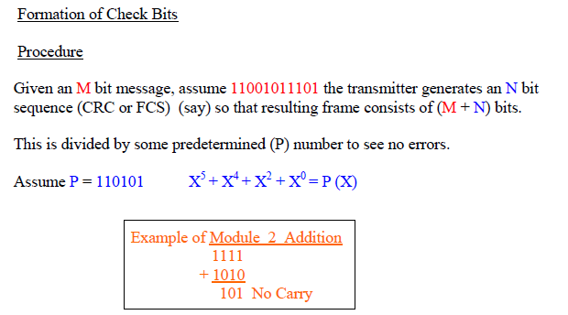
EXAMPLE ON CRC

Slide 25
In order to formulate the CRC the message of 11 bits (assume) has been shifted by 5 bits and the total modified message has been divided in modulo 2 division by the polynomial which is shown below
1
0
0
1
0
1
1
0
1
0
0
1
1
0
1
0
1
1
1
0
0
1
0
1
1
1
0
1
0
0
0
0
0
1
1
0
1
0
1
0
0
0
1
1
1
1
0
0
0
0
0
0
0
0
1
1
1
1
1
0
0
0
0
0
0
0
1
1
1
1
1
1
1
1
0
1
0
1
0
0
1
0
1
0
0
0
0
0
0
0
0
You will see the residual as 00100 and the quotient is 100101101
0
1
0
1
0
0
1
1
1
0
1
0
1
0
1
1
1
0
0
0
1
1
0
1
0
1
0
0
1
1
0
1
0
0
0
0
0
0
0
0
1
1
0
1
0
0
1
1
0
1
0
1
Hence transmit word:
11001011101 : 00100
0
0
0
0
0
1
0
0
0
0
0
0
0
0
0
0
0
1
0
0
0
0
0
0
0
0
0
0
0
1
0
0

Slide 26
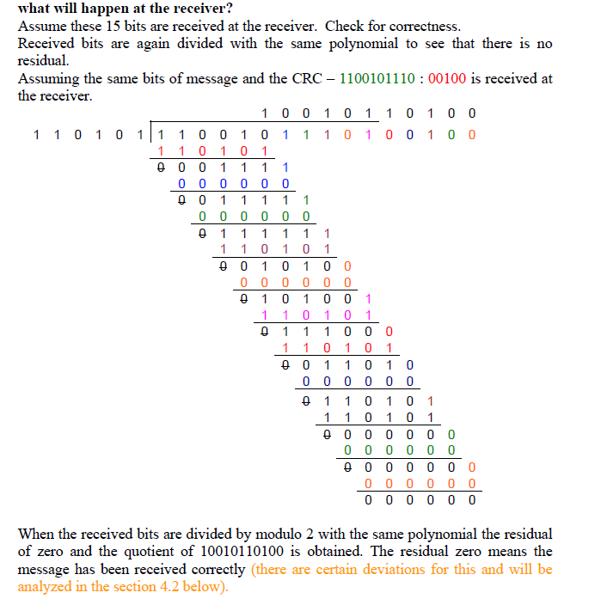

Slide 28

Understanding cyclic redundancy code of error correction
(Question)

Slide 29
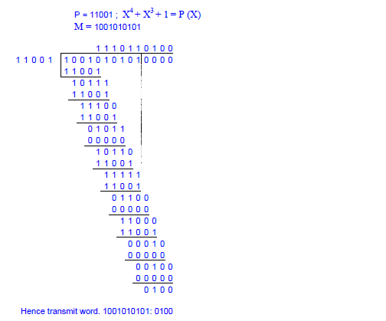

Slide 30
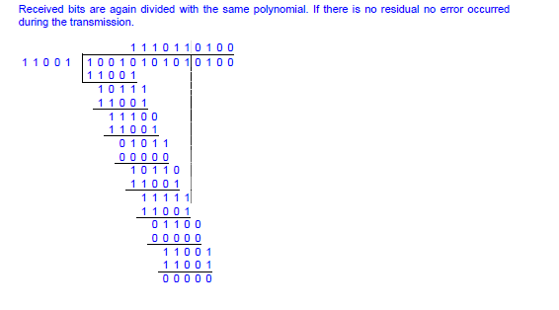
Hence there are no errors

Slide 31
Hint to answer
Write the polynomial in x
Draw the 1 bit shift registers and the circuit diagram
Write the timing equations for n+1 th step for each output
Sketh the output map– no of columns=no of outputs+steps+input(pl add to the message the no of zeros or crc depending upon the situation, no of rows has to be input+2
Carryout the timing equation for each step, the last step will give you the output

Slide 32
CRC
Polynomial:P=11001,P(x)=x⁴+x³+x⁰
X⁴ X³ X² X¹ X⁰
^{Timing equations}
A_{n} + I_{n} = D_{n+1}
D_{n} = C_{n+1}
C_{n} = B_{n+1}
A_{n} + B_{n} = A_{n+1}
Input Data
I
+
+
A
B
C
D

Slide 33
A_{n} + B_{n} = A_{n+1}
C_{n} = B_{n+1}
C_{n+1}= D_{n+1}
A_{n} + I_{n} = D_{n+1}
Step | A | B | C | D | Input
0
1
2
3
4
5
6
7
8
9
10
11
12
13
14
15
0 | 0 | 0 | 0 | Reset
0 | 0 | 0 | 0 | 1
0 | 0 | 0 | 1 | 0
0 | 0 | 1 | 0 | 0
0 | 1 | 0 | 0 | 1
1 | 0 | 0 | 1 | 0
1 | 0 | 1 | 1 | 1
1 | 1 | 1 | 0 | 0
0 | 1 | 0 | 1 | 1
1 | 0 | 1 | 1 | 0
1 | 1 | 1 | 1 | 1
0 | 1 | 1 | 0 | 0
1 | 1 | 0 | 0 | 0
0 | 0 | 0 | 1 | 0
0 | 0 | 1 | 0 | 0
0 | 1 | 0 | 0 | Out put

Slide 34
A_{n} + B_{n} = A_{n+1}
C_{n} = B_{n+1}
C_{n+1}= D_{n+1}
A_{n} + I_{n} = D_{n+1}
Step | A | B | C | D | Input
0 | 0 | 0 | 0 | 0 | Reset
1 | 0 | 0 | 0 | 0 | 1
2 | 0 | 0 | 0 | 1 | 0
3 | 0 | 0 | 1 | 0 | 0
4 | 0 | 1 | 0 | 0 | 1
5 | 1 | 0 | 0 | 1 | 0
6 | 1 | 0 | 1 | 1 | 1
7 | 1 | 1 | 1 | 0 | 0
8 | 0 | 1 | 0 | 1 | 1
9 | 1 | 0 | 1 | 1 | 0
10 | 1 | 1 | 1 | 1 | 1
11 | 0 | 1 | 1 | 0 | 0
12 | 1 | 1 | 0 | 0 | 0
13 | 0 | 0 | 0 | 1 | 0
14 | 0 | 0 | 1 | 0 | 0
15 | 0 | 1 | 0 | 0 | Out put

Slide 35
QUESTION
SHOW THE FOLLOWING RECEIVED MESSAGE IS IN ERROR,FOR THE SAME TRASMITTED MESSAGE ie 10010101010100
Received message:10110100010100
WRITE THE ERROR MESSAGE EQUATION

Slide 36
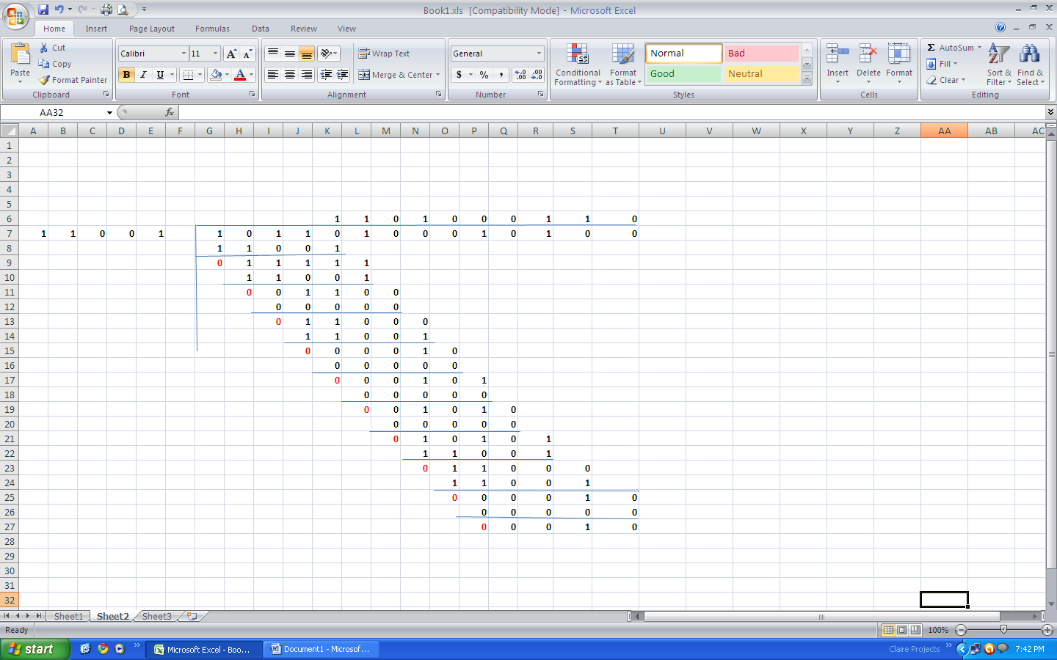
The remainder 00010 implies that there is an error

Slide 37
ERROR EQUATION
TRANSMITTED MESSAGE + RECIEVED= ERROR MESSAGE
10010101010100
10110100010100
00100001000000 = ERROR MESSAGE
E(X)=X⁶ + X¹¹

Slide 38
INSTANCES WHERE THE CRC IS FAILED TO ANSWER?
THER ARE INSTANCES WHERE THE CRC WILL FAILED TO ANSWER, ONE SUCH INSTANCES WILL BE WHEN THERE ARE ERRORS INTRODUCED EQUAL TO THE POLYNOMIAL

Slide 39
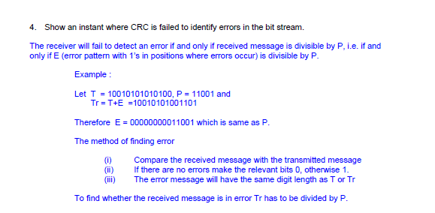

Slide 40
WHEN ERROR MESSAGE IS EQUAL TO THE POLYNOMIAL (EXAMPLE)
ASSUME THE FOLLOWING
TRANSMITTED MESSAGE
100101010100
RECEIEVED MESSAGE
100101001101
POLYNOMIAL
1101
SHOW THAT CRC IS FAILED TO IDENTIFY THE ERROR IN THE MESSAGE?

Slide 42
THOUGH THE RESIDUAL IS 0 THERE IS AN ERROR IN THE RECEIEVED MESSAGE
Hint divide the received message by mod 2
Then observe that no residuals
Write the error message & compare with the polynomial

Slide 43
TRY A CRC SUM
TRANSMIT MESSAGE
11001011101
POLYNOMIAL
101101
FIND OUT THE CRC
DRAW THE CIRCUIT DIAGRAM AND SHOW CLEARLY HOW YOU PRODUCE CRC?

Slide 44
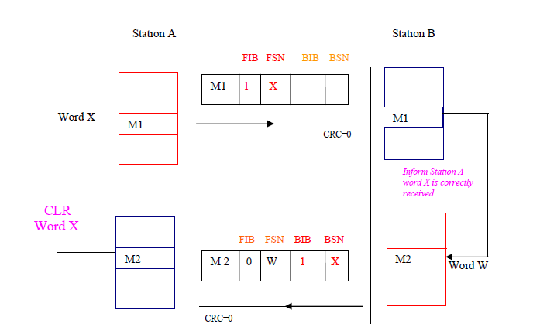
How a message is transmitted

Slide 45
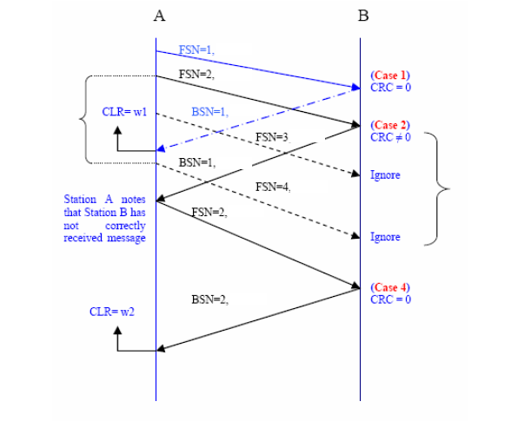
Preventive cycle retransmission method of error correction

Slide 46
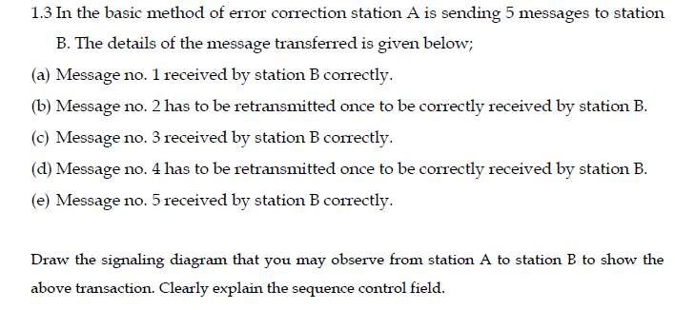
Question on basic method

Slide 47
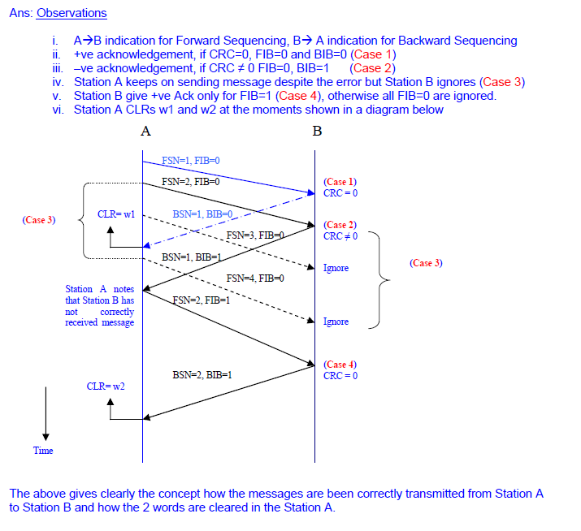

Slide 48
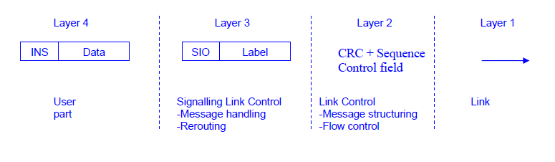
4 layers of CCITT no:7

Slide 49
How CCITT No:7 works- Study about the layered structure
Layer 1
Layer 2
Layer 3
Layer 4
Layer 4
Layer 3
Layer 2
CRC=0
W0
FSN=5,FIB=1
Instructions
DATA
SIO
Label
k1
W5
SCF
K2
SCF
K2
K2
K1
k1
k2
W127
SCF=Sequence control field
DPC=st B
LABEL CONTENTS
BSN=5,BIB=1
Clear W5
SCF
OPC|DPC|CIC
User Part
Signaling Link
Link Control
Message type
Error detection and correction
Message handline
Signal control
Actual message
Station A
Station B

Slide 50
How reroutine is done?
Layer 4
Layer 3
Layer 2
Layer 1
Layer 2
Layer 3
CRC=0
W0
FSN=5,FIB=1
DATA
SIO
Label
k1
W5
SCF
K2
SCF
K2
K2
k1
k2
W127
DPC=st C
SCF=Sequence control field
Station A
BSN=5,BIB=1
Clear W5
SCF
SCF
K2
W10
Station B
FSN10 ,BIB0
K1
K2
SCF
K2
Station C

Slide 51
OSI 7 LAYERS
MUCH MORE VALUE ADDITION HAS BEEN ADDED TO THE MESSAGE PART IN OSI 7 LAYERS
VIRTUALLY THE CCITT NO7 LAYER4 IS BEEN VALUE ADDED , WHILE THE OTHER PARTS REMAINS SAME.
LAYER4 IS BEEN ADDED WITH ANOTHER 4 LAYERS, i.e TRANSPORT, SESSION, PRESENTATION & APPLICATION

Slide 52
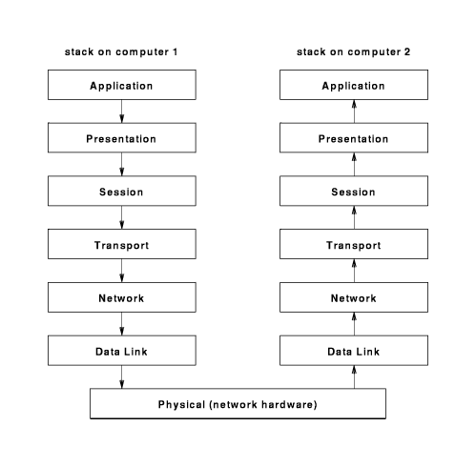
OSI 7 LAYERS

Slide 53
Physical Layer
To transmit bits over a medium. To provide mechanical and electrical specifications
Unit is bits
A/D conversions, Error control coding, Multiplexing, Modulation
Data Link Layer
To organize bits into frames. To provide hop to hop delivery.
Unit is frames
Buffering, Framing, Error control, Flow control
Network Layer
To move packets from source to destination. To provide internetworking.
Unit is packets
-Routing, Congestion control, Compatibility issues with internetworking

Slide 54
Transport Layer
To provide reliable process to process data delivery and recovery.
Unit is segments.
Sessions Layer
To establish, manage and terminate sessions.
Unit is message.
Presentation Layer
To translate, compress and encrypt data.
Unit is message.
Application layer
To allow access to network structure. Manages programme requests that require access to services provided by a remote system.
Unit is message.

Slide 55
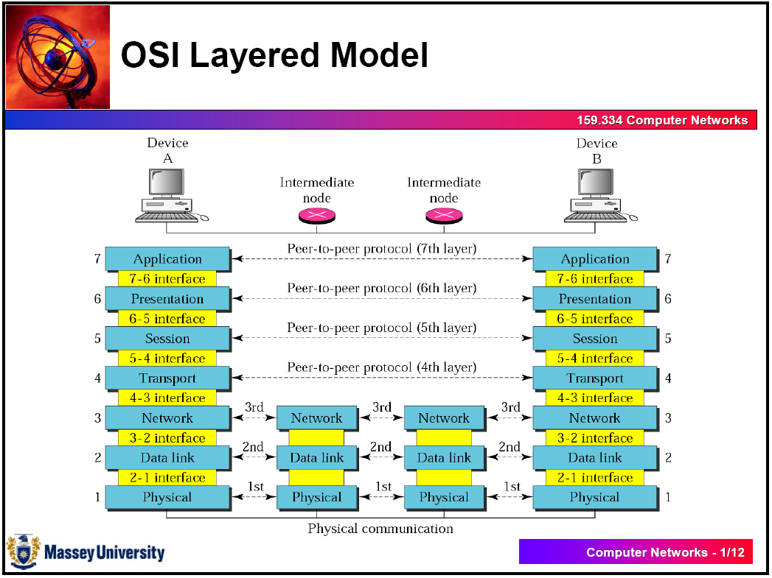

Slide 56
TWO MAIN CONNECTION TYPES
Connection oriented
This requires 2 processers to establish a connection before sending data.
A logical connection will be established by having both sides initializing variables and counters that keep count of which frames have arrived and which ones have not.
The path which will be established is called a virtual circuit.

Slide 57
TWO MAIN CONNECTION TYPES
Connectionless
In connection less the data packets are sent independent of each other so they might not arrive at the destination on proper order.
Unlike connection oriented, in connectionless an advanced set up is not required so the data frames can get lost, corrupted, duplicated or out of order.
In this context, packets are called datagrams. Datagrams carry full destination address and each is routed through the system independent of all the others.

Slide 58
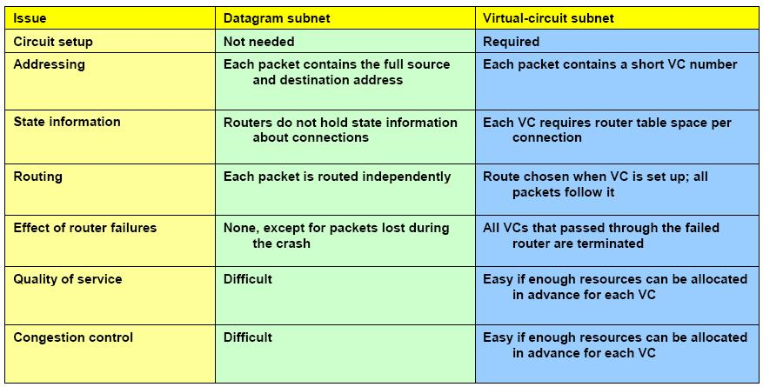
Comparison of connection types

Slide 59
TUTORIALS ON ERROR CONTROL
EXPLAIN THE DIFFERENCE BETWEEN FORWARD AND BACKWARD ERROR CORRECTION, AND WHAT ARE ITS APPLICATION AREAS.
SHOW AN ONE OCCATION THE CRC WILL NOT DETECT AN ERROR?
CALCULATE CRC WHERE THE MESSAGE IS 1001010101 WHERE THE POLYNOMIAL USED IS 11001
DRAW THE SCHMETIC DIAGRAM HOW YOU ARE GOING TO FORM THE CRC BY USING 1 BIT SHIFT REGISTERS, AND SHOW ALL THE STEPS UPTO THE FORMATION OF CRC.

Slide 60
DETAILS OF PHYSICAL LAYER
PHYSICAL LAYER CONSIST OF MANY TYPES OF CONNECTIONS. THEY BOLONGS TO ONE OF THE FOLLOWING TYPES
WIRED CONNECTION (ELECTRICAL SIGNALS THROUGHOUT)
WIRELESS CONNECTIONS
OPTICAL FIBRE CONNECTIONS
LETS ANALYSE GENERALLY WHAT ARE THE PHYSICAL CONNECTIONS

Slide 61
Transport Layer
To provide reliable process to process data delivery and recovery.
Unit is segments.
Sessions Layer
To establish, manage and terminate sessions.
Unit is message.
Presentation Layer
To translate, compress and encrypt data.
Unit is message.
Application layer
To allow access to network structure. Manages programme requests that require access to services provided by a remote system.
Unit is message.

Slide 62

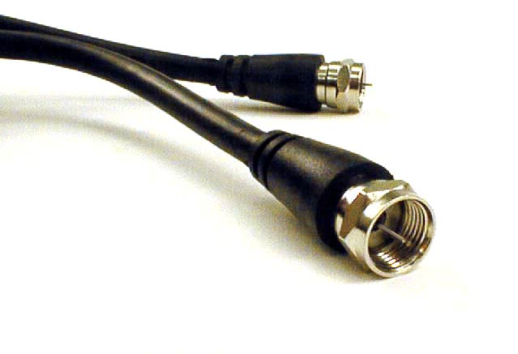
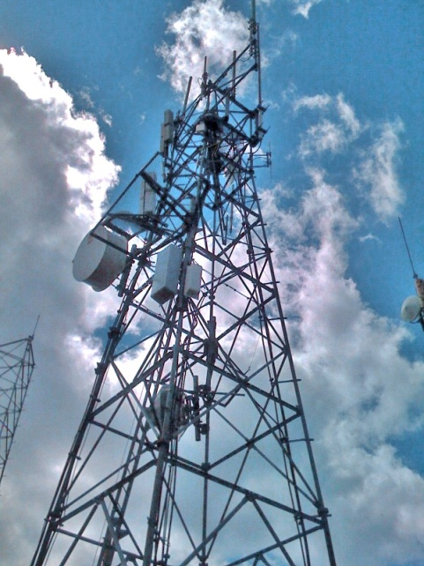
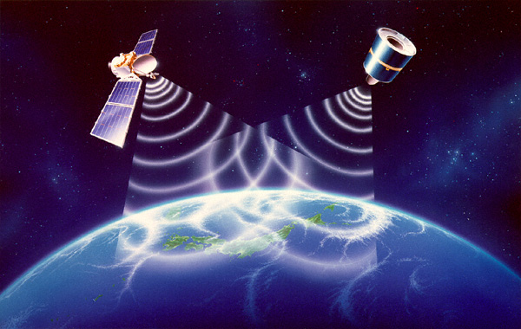
What does the physical layer do?
Interfaces the electrical signals with actual physical medium.
How can that be achieved?
Twisted pair of lines
Coaxial cable
Optical fibre
Satellite
Microwave and radio
High frequency radio

Slide 63
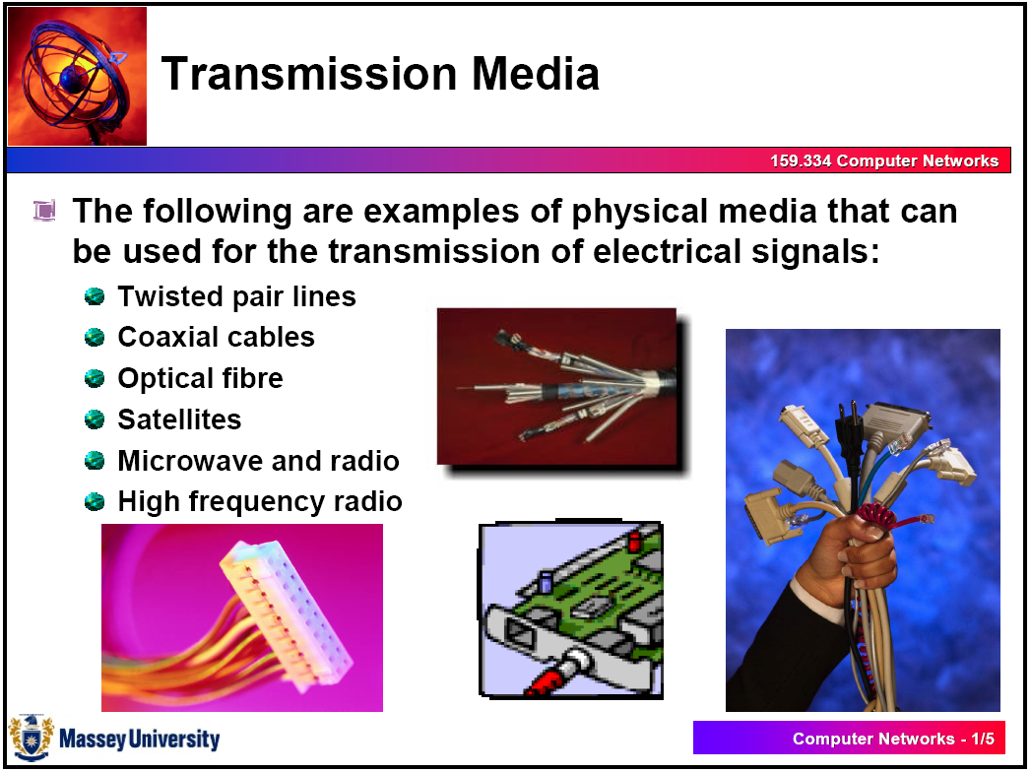

Slide 64
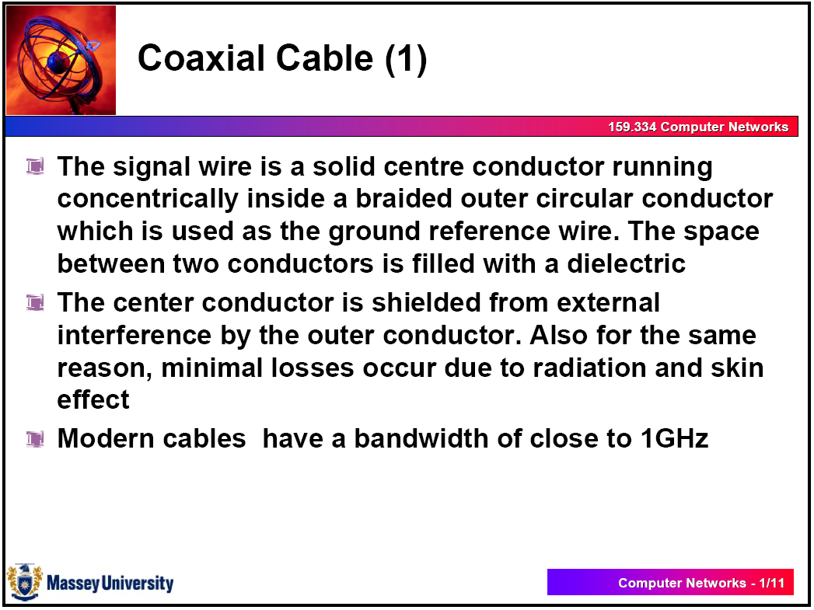

Slide 65
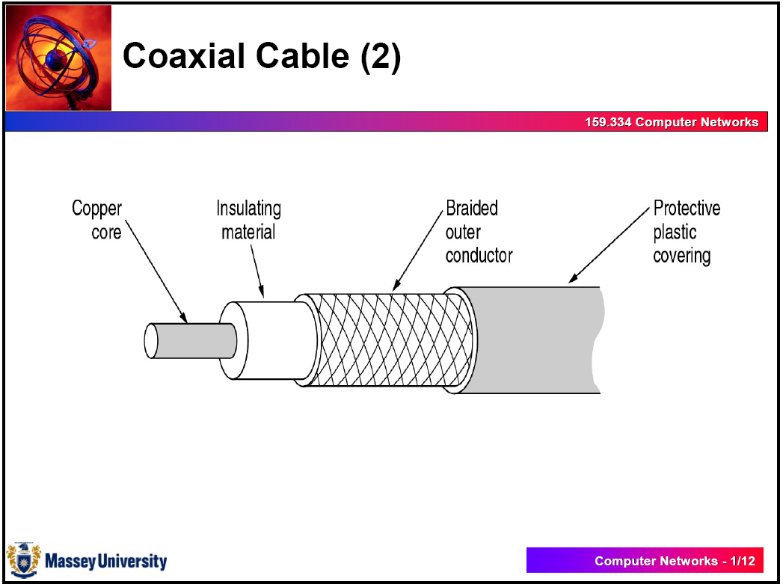

Slide 66
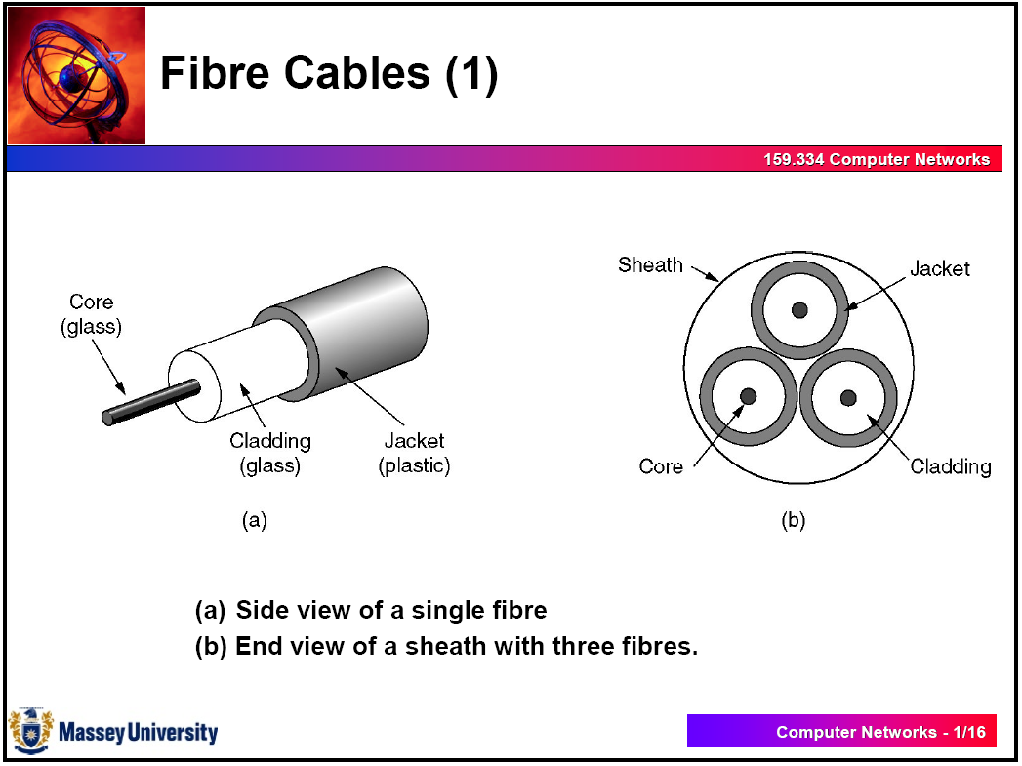

Slide 67
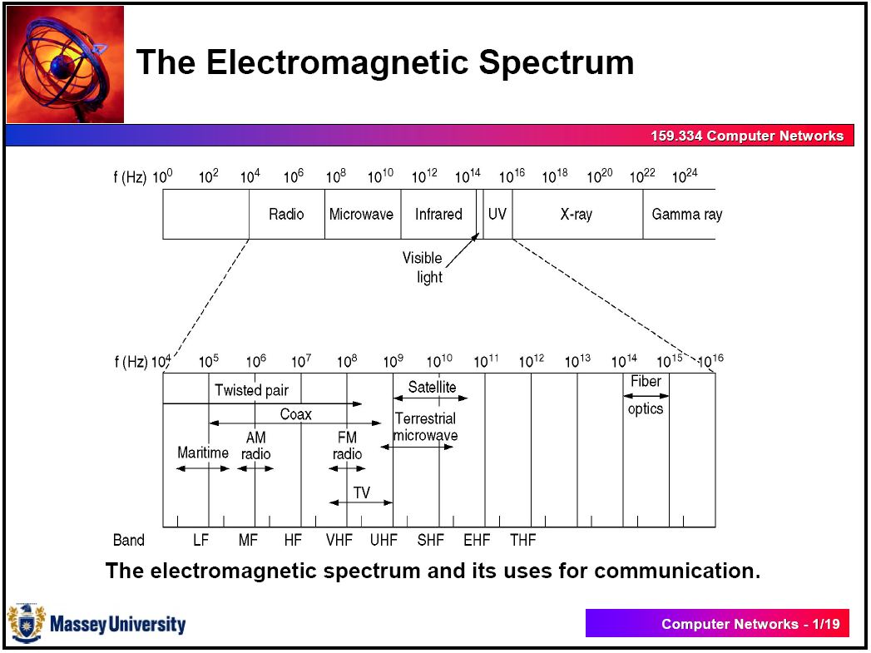

Slide 68
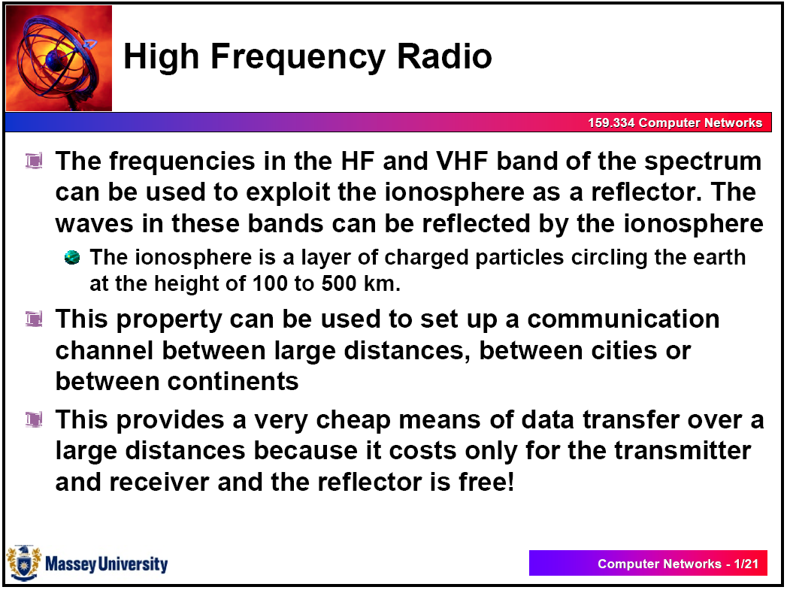

Slide 69
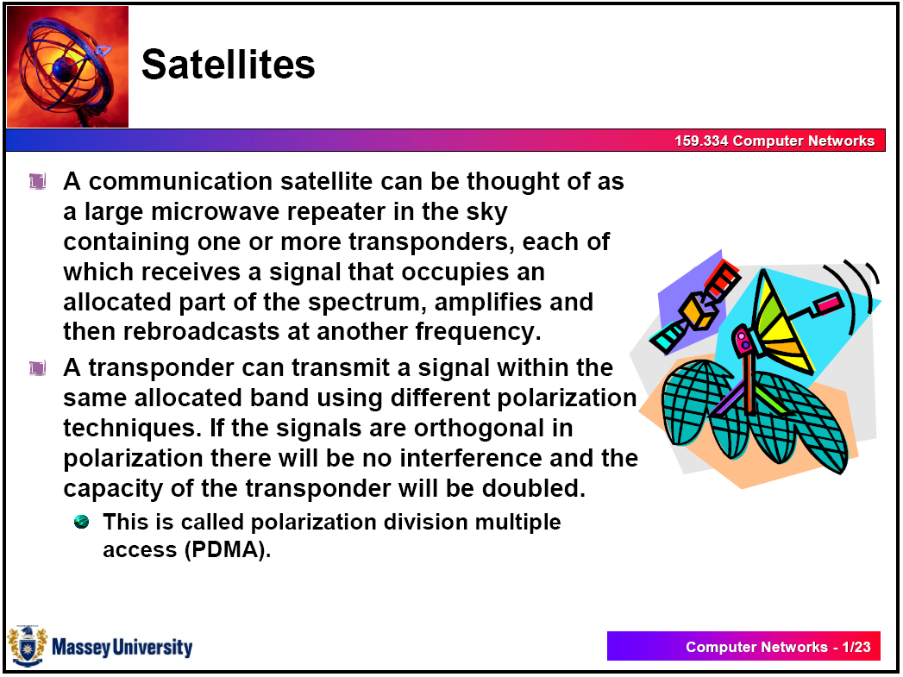

Slide 70
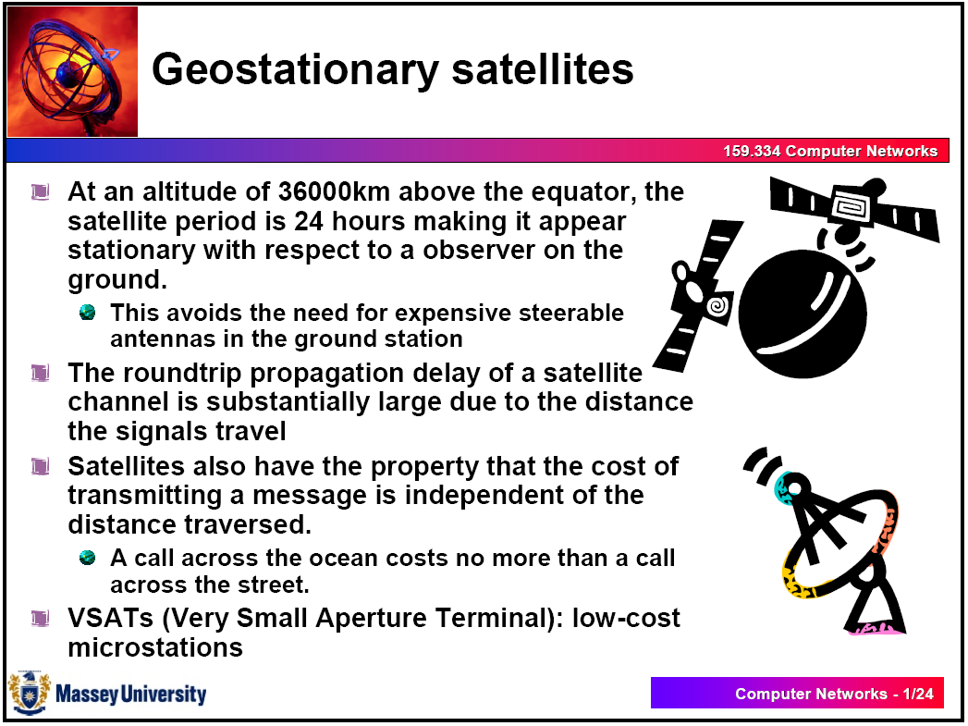

Slide 71
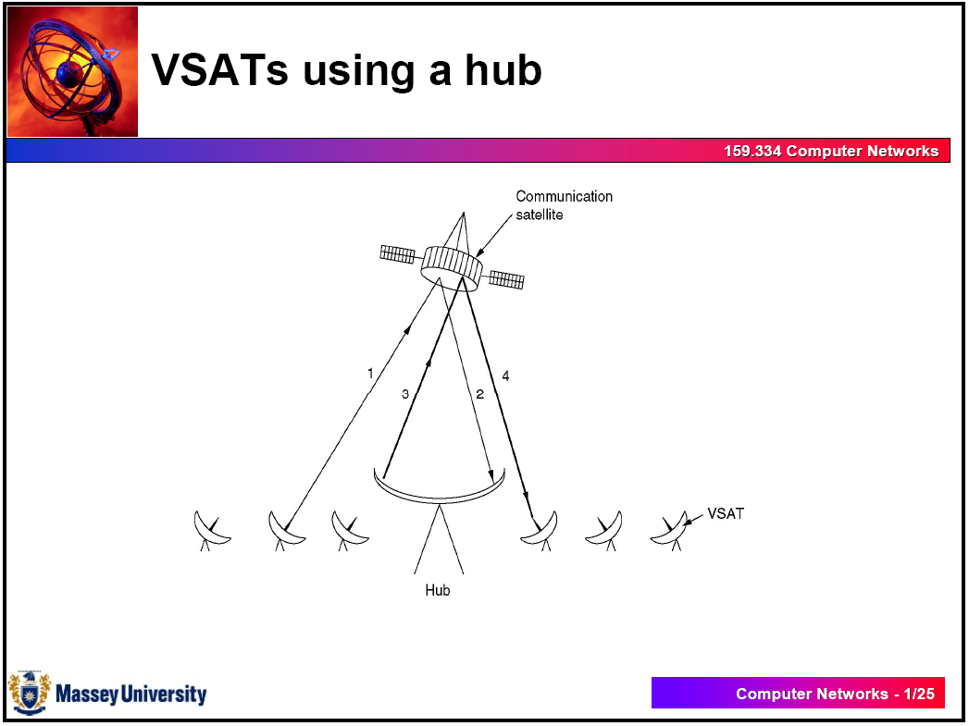

Slide 72
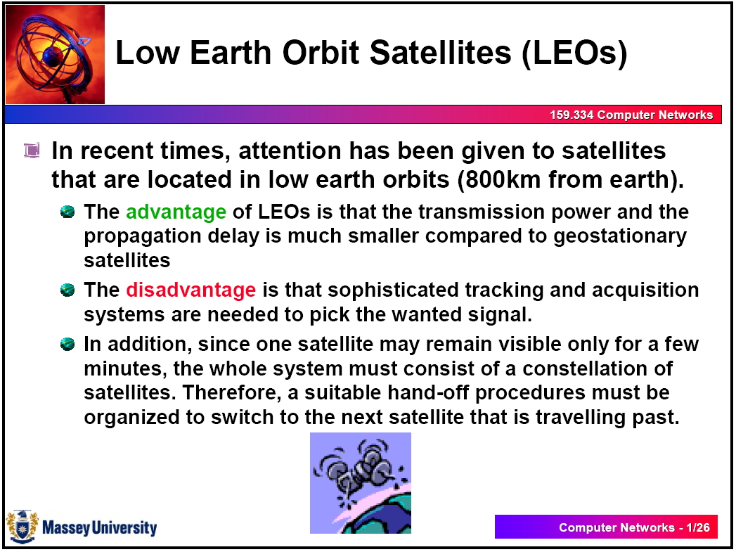

Slide 73
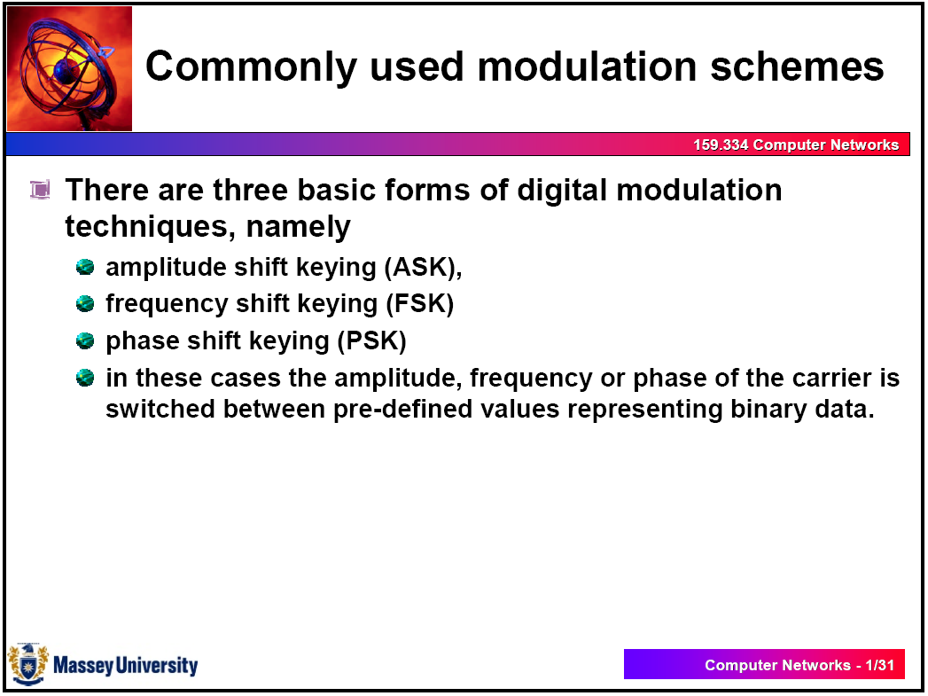

Slide 74
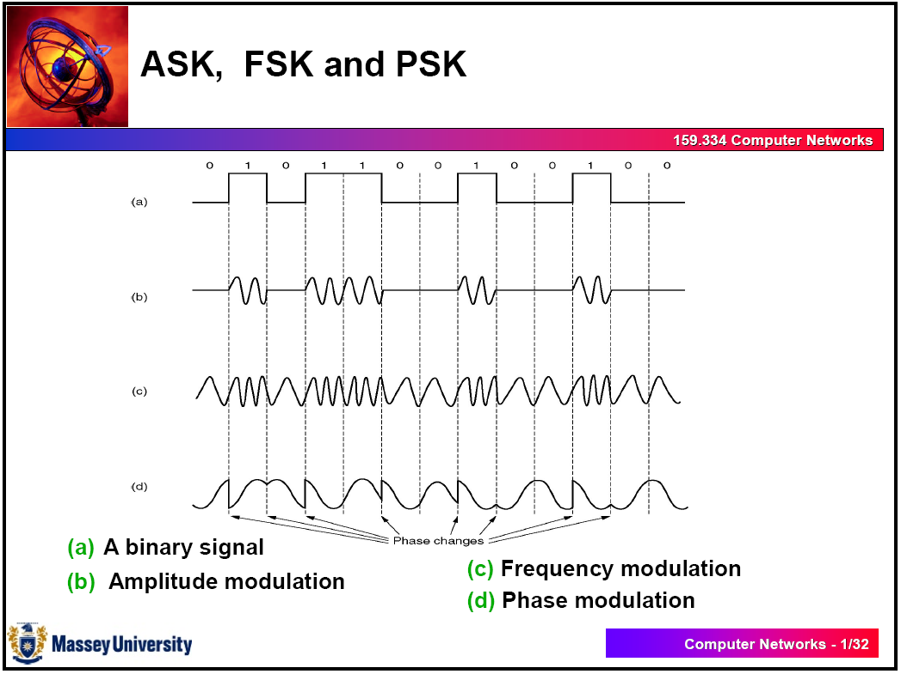

Slide 75
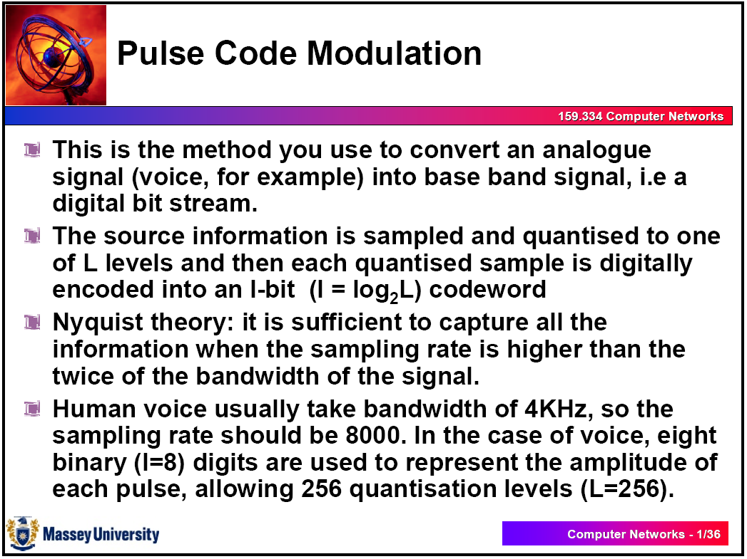

Slide 76
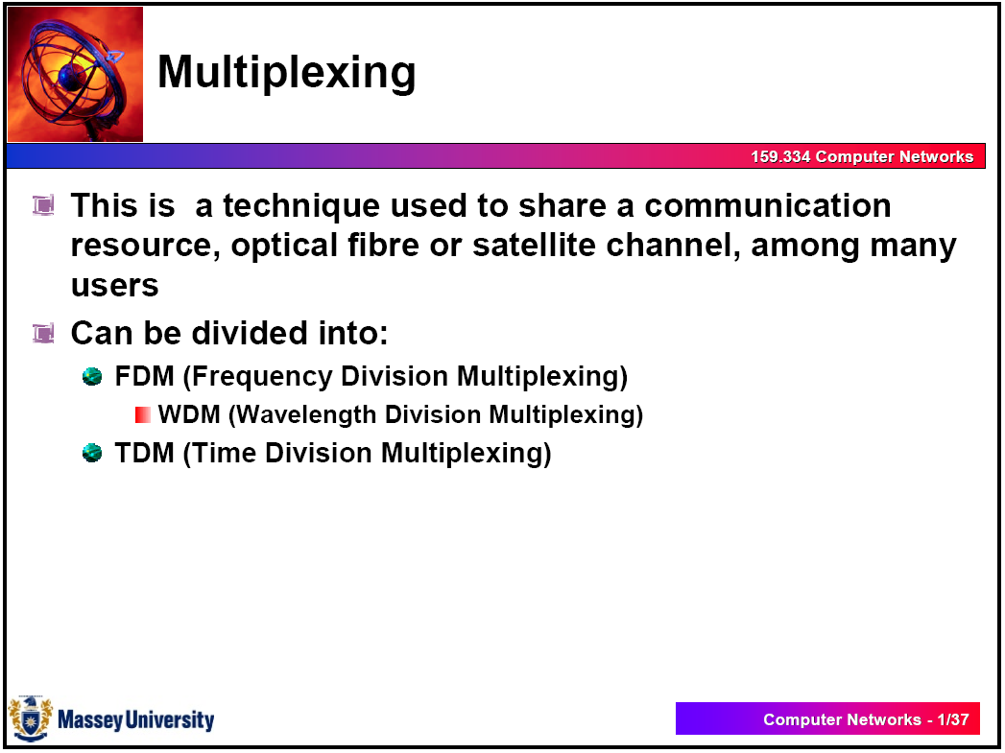

Slide 77
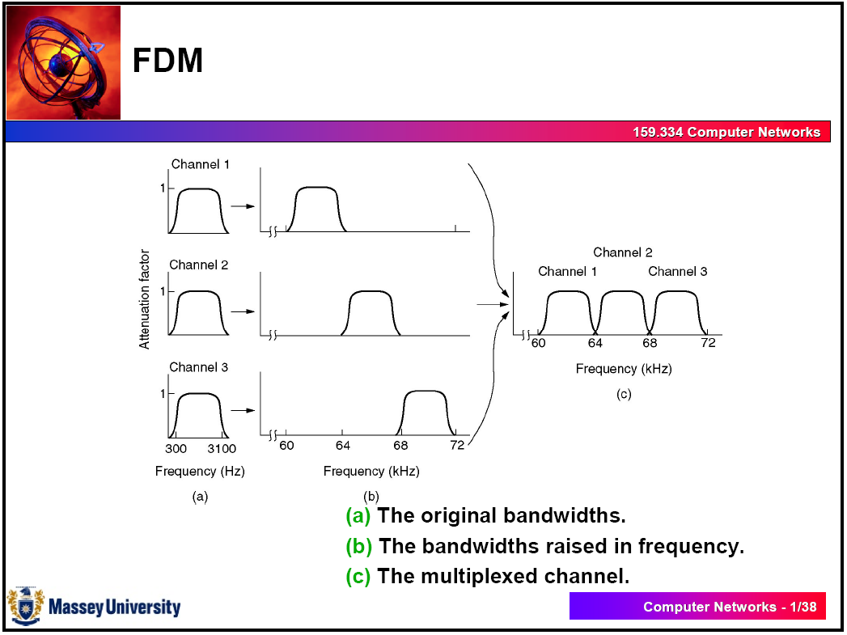

Slide 78
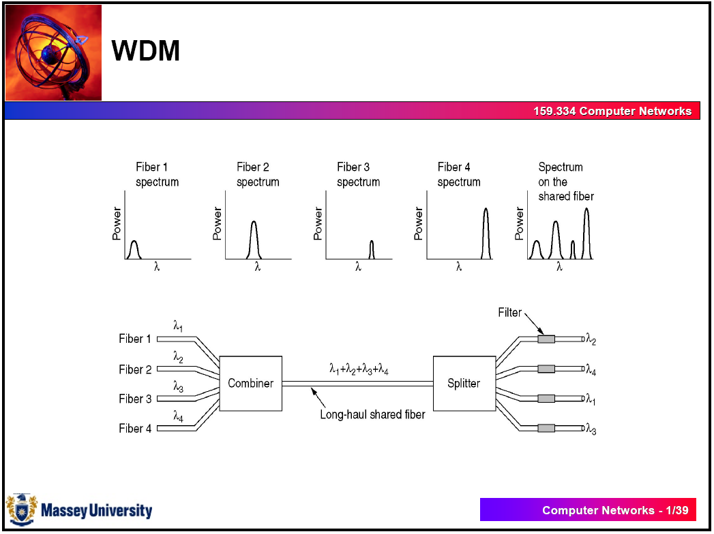

Slide 79
CONCLUTIONS
WE HAVE STUDIED LAYER 1, THE DETAIED STUDY DONE IN PCM & HIGHER ORDER PCM WILL ALLOW YOU TO UNDERSTAND MORE ON TO THE PRACTICAL APPLICATION OF LAYER 1
LAYER 2 & 3 ALREADY DETAILED OUT
IF YOU UNDERSTAND THE CONCEPTS UPTO NOW, YOU CAN STUDY THE REST OF LAYERS IN OSI MODEL

